Slide 1
Proposal for the Installation of LED Screens on Toll Plaza PAN India
Prefix
Introduction of the Company
Body of work
Hardware and Software
Installation
SOP of BOT/Empowerment/Royalty
Installation Timeframe
Deliverables
Expectations
AMC

Slide 2
Introduction of the Company:
We are a member of the largest Independent communication network (ICOM) in the world.
With offices in Mumbai, New Delhi, Ahmedabad & Bangalore we have been building and nurturing some of the leading brands in the country across diverse categories by delivering seamless integrated communication solutions for all our client needs.
With close to around 185 professionals across major cities in India, our integrated communication solutions include:-
Brand Planning
Creative
Media Planning
Media Buying
Digital
Corporate Identity
Events and Activations
Some of our key clients include Godrej Properties (Godrej Central & Godrej Prime), Eureka Forbes (Aquaguard), Yes Bank , Adani Wilmar , Force Motors, Escorts, Alliance Tire Group, Allied Blenders and Distillers (Officer’s Choice- Largest selling whisky in the world), UB Group (Kingfisher Storm, Kingfisher Blue, Kingfisher Buzz and other local and developmental brands), NECC / Venkys, Wockhardt among others.
Over the years, we have grown brands against well ensconced competition both domestic and multinational to leadership status. Some of the key achievements are :
Launched and Build Set Wet range of grooming products.
Launched Aquaguard to make it the undisputed leader in the water purifier category.
Launched and build Moov into a number 1 Backache specialist.
Launched Samsung mobile handsets In India
Helped make Officer’s Choice the largest selling whisky brand in the world.
Launched Fortune cooking Oil to make it the no. 1 edible oil brand in the country.
Launched Yes Bank to make it the 4th largest private bank in the country.
Our capabilities include both B2B and B2C space.
Will be a pleasure to work with you and take relationship forward. Please let us know the next steps on the same.
Looking forward to hear from you in affirmative.

Slide 3
Events and Activations
Some of our key clients include Godrej Properties (Godrej Central & Godrej Prime), Eureka Forbes (Aquaguard), Yes Bank , Adani Wilmar , Force Motors, Escorts, Alliance Tire Group, Allied Blenders and Distillers (Officer’s Choice- Largest selling whisky in the world), UB Group (Kingfisher Storm, Kingfisher Blue, Kingfisher Buzz and other local and developmental brands), NECC / Venkys, Wockhardt among others.
Over the years, we have grown brands against well ensconced competition both domestic and multinational to leadership status. Some of the key achievements are :
Launched and Build Set Wet range of grooming products.
Launched Aquaguard to make it the undisputed leader in the water purifier category.
Launched and build Moov into a number 1 Backache specialist.
Launched Samsung mobile handsets In India
Helped make Officer’s Choice the largest selling whisky brand in the world.
Launched Fortune cooking Oil to make it the no. 1 edible oil brand in the country.
Launched Yes Bank to make it the 4th largest private bank in the country.
Our capabilities include both B2B and B2C space.

Slide 4
Body of work:
The idea behind the installation of the large screen at at every toll plaza will to be to create a visual awareness for the commuter in different facets of life
There will be advertisements for the sponsors
Government run advertisements
Safety issues and standards
Traffic updates
And Public Messages
Various aspects of road safety
Health tips
Traffic updates
Routes
Congestion
Advertisements
Nearest Utilities
Exit points etc.

Slide 5
Details of Hardware and Software
Hardware:
Bigger pipe dia - 200 mm
Smaller pipe dia - 150 mm
Both pipes will be connected by flanges
Pipe will be mounted in concrete base by anchor bolts
Pipe will be supported by C-channel on both sides(front n back) to cater wind load
C- channel frame will be mounted on top of pipe to support digital board
3 pipe supports are required for 9ft x 27ft advertising board
Rough working time -
Fabrication time - 2 days
Erecting time - 1 day
Concrete work (if required) - 4 days
Transit time - as applicable
Approximate time to install structures for 100 (phase I) boards - around 90 days
Surface finish shall be
oil paint+ radium ( considering all seasons + night vision - for life of 10 years)

Slide 6
Hardware LED Tech Specs:

Slide 8
17 | Cabinet Material: |  | Iron/Aluminum
18 | Color (M): |  | >16.7
19 | Input Voltage (V): |  | AC 110V~220V+/-10%
20 | Refresh Frame Frequency (Hz): |  | 60
21 | Protection Level: |  | IP65
22 | Working Temperature (℃): |  | -30°- +60°
23 | Operation humidity (RH): |  | 10%-95%
24 | Certificates: |  | CCC 、CE、RoHS

Slide 9
Installation of Hardware and Software:
LED Grid display will be integrated with a controller which will be attached to a processor which will run the software for the content of desired choice
The processor will have a internet connectivity which will upload the content to the desired location, content will be software driven
Software will have the ability to change the content from the HUB at a specific location , it can be driven to change the content during certain timing automatically
Content will be designed in such a way that the commuter will be able to view it from a distance of about 100mts
Content will be anything that is required to be played and controlled by software for e.g.…advertisement, movies safety issues, etc. etc.
Back up will be provide by Diesel generator and surpassed with on Online UPS of the correct Wattage
Bespoke software to run on all the stand alone systems powered through a powerful quad core processor for the running of the content.
Software will have the ability to change the content as per the setting and time duration mentioned in the settings
Software can be remotely operated on for individual machine and POD PAN India through internet connectivity

Slide 10
Installation of POD
Erecting time - 1 day
Concrete work (if required) - 4 days
Transit time - as applicable
Approximate time to install structures for 100 (phase I) boards - around 90 days
Surface finish shall be
oil paint+ radium ( considering all seasons + night vision - for life of 10 years)
Or powder coating is also an option
Consists of LED Panels 3ft X 3ft
Each screen consisting of a grind of 12ft by 27 ft. with a total area of 324 sq. ft. if 3X3 LED panels used.
Weight of each 3X3 panel of LED is 35kg
Each POD will have its electrical supply of its own and will have a generator back up to adhere to the SLA and UPS for uninterrupted power supply
The Design of the Pod will be made in such a way that it is a safe structure and will provide maximum visibility of the content that is run on the screen

Slide 11
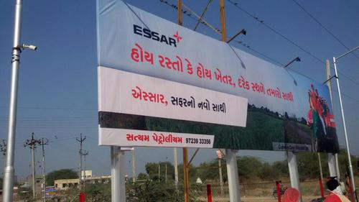

Slide 12
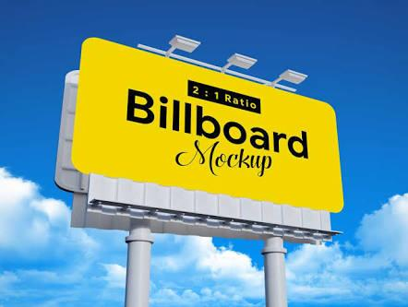

Slide 13
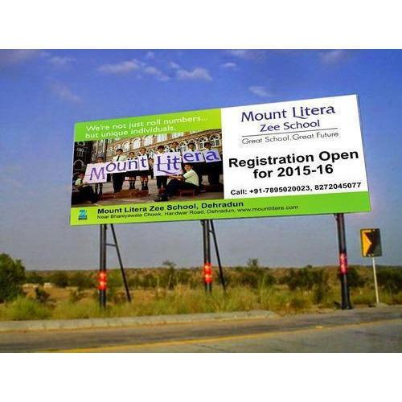

Slide 14
Software:
Software will be bespoke and designed in such a way that all the content that is played on the different screens PAN India will be able to be monitored from a HUB
The content will be able to uploaded from the HUB
Changes will be made from the HUB
Timing and Date schedules will be remotely operated

Slide 15
SOP of BOT/Empowerment/Royalty
Tenure of the Project: 9 to 12 yrs.
Project Costing:
Phase 1: 50 Cr with 150 Toll Plaza PAN India
Phase 2: 50 Cr with 150 Toll Plaza PAN India
Phase 3: 85 Cr with 250 Toll Plaza PAN India

Slide 16
Installation Timeframe
Phase 1 – 1 Year
Phase 2 – 6 Months
Phase 3 – 1.5 Years
ROI – will be effective after 2.5 Years of Installation

Slide 17
Deliverables
10% of Air Time Slot in 24 Hrs. for the safety and awareness and most of all for **EMERGENCY MESSAGES**.
We will be having a Motorist Reach of 10 Cr. On a normal Day across India

Slide 18
Expectations
Lease term of 9 yrs.
Adv Space at Toll Plaza before the Rumblers
Adv Space at the Toll Ahead Sign
Adv Space on Over bridges PAN India
Electric Supply of 20 KV and Backup

Slide 19
AMC
AMC: for the entire project will be 25% of the total Project Cost and will remain in the founder company's hands even after the Lease tenure is over

